Slide 1

Something To Wine About
Wine for Dummies
Madison, Saya, Thomas, Kyle, Kara
Notes:
Madison Jenkins, Saya Uchiyama, Thomas Laws, Kyle K, Kara Hodges

Slide 2
Project Summary
Wine comes in hundreds of varieties from all over the world at a wide range of prices, so our key focus was on ratings and what impact these factors had on it:
Where is the best wine produced?
Does better wine cost more?
Does wine get better year by year?
What variety of wine is the best?
Where is the best wine from that is the lowest price?

Slide 3
Data
Gathered from Wine Enthusiast Magazine
A US-based wine magazine with 800,000+ readers
Reviews from 19 different wine experts
Data scraped in Nov 2017 and posted on Kaggle
118,840 unique wines
Data on each wine includes the country of origin, year, price, rating, reviewer, winery, and description
42% of wines came from the US

Slide 4
Data: Pre Analysis
Data cleanup process was simple
All currency was already USD
All duplicates were already removed
We dropped unnecessary rows
Wine Enthusiasts’ 100-point wine-scoring scale:
98–100 – Classic
94–97 – Superb
90–93 – Excellent
87–89 – Very good
83–86 – Good
80–82 – Acceptable
Average Cost of Wine in dataset: $35
Average Rating: 88.4

Slide 5
Data Analysis Overview
Compared ratings against four factors
Price
Location
Time
Variety

Slide 6
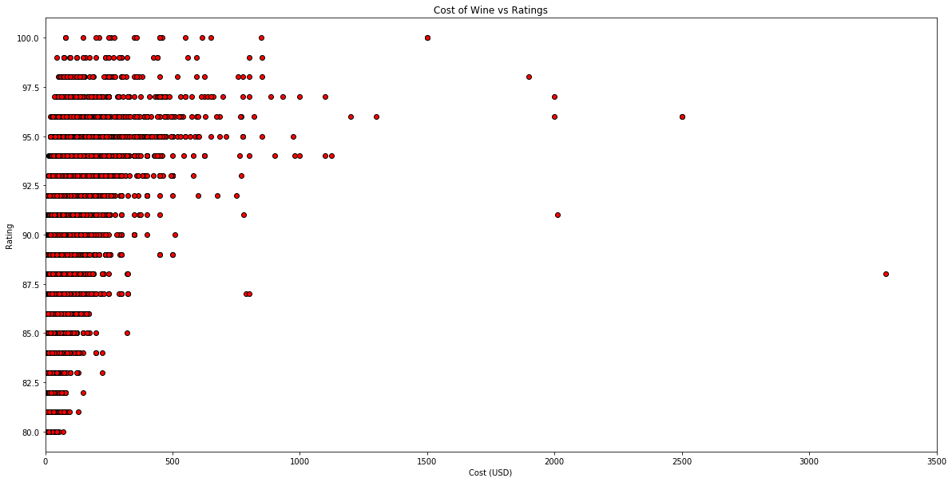
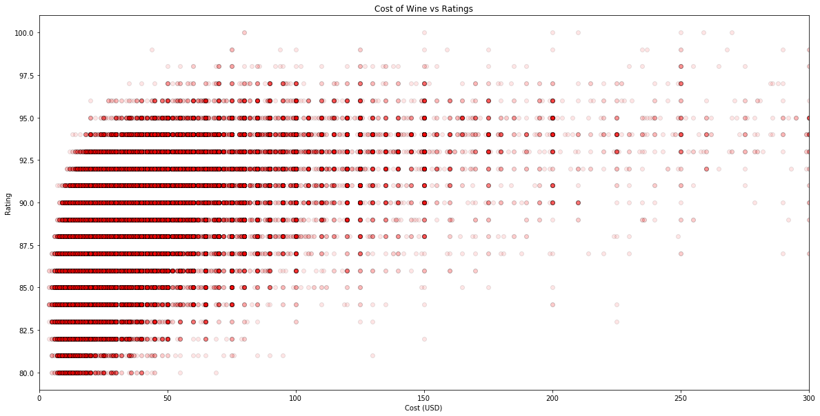
Price
Is there a correlation between price and quality?
Cost of Wine vs Ratings
Cost of Wine vs Ratings
Ratings
Ratings
Cost (USD)
Cost (USD)
Notes:
-The scatterplot on the left shows us that the most expensive wines are not necessarily the highest rated. To determine this, I sorted our dataset by wine price (x-axis) and wine ratings (y-axis) and combined them on the scatterplot to answer the question “Does more expensive wine have higher ratings?”. This finding was surprising because we expected that expensive wines would be rated in the “Classic” (98-100 points) but most are in the “Superb” category (94-97 points). This diagram also shows that the most expensive wines are the outliers in this dataset.
-The scatterplot on the right shows us that the majority of wines are under $150.00. Also, we can see that the cheapest wines have the worst ratings, as we expected. For this, I used the same graph as before, but changed the limit so the display was zoomed in to allow us to see trends on the y-axis more clearly.

Slide 7
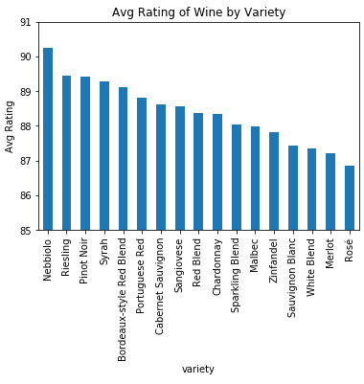
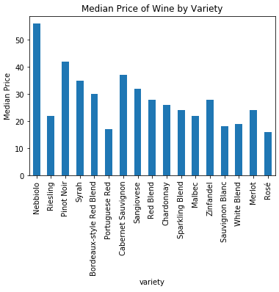
Variety
Do wine varieties vary in rating and price?
Notes:
The first graph shows the average rating of the most reviewed wines. Certain wine varieties do tend to rate higher, and picking a specific variety can be the difference between a “Very Good” and “Excellent” wine
The second graph We see the trend of higher priced wines having higher ratings continue here when looking at individual wine varieties.
Price plays an important factor in many cases though. For example, you could spend half as much on a Riesling with a rating just as good as a Pinot Noir, assuming rating was an important factor to you

Slide 8
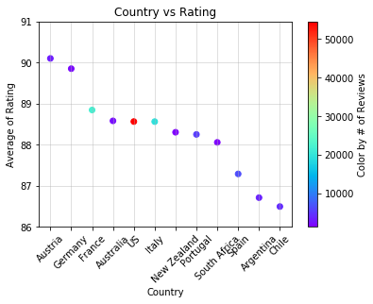
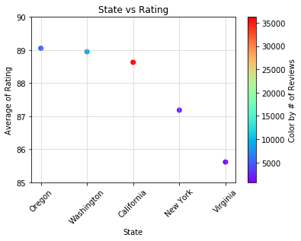
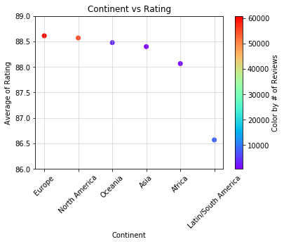
Location
Where is highly rated wine from?
Globally, Austria had the highest rating
Within US, wines from Oregon State had the highest ratings
By grouping them by continent, Latin/South America has the lowest rating.
Notes:
We compared the average of rating scores to countries with more than 1000 reviews in the left chart. Austria wine has the highest rating. The rainbow color label shows how many reviews were in for each country to show where is the popular places for wines producing. Within US, Oregon wine has the highest rating. When we group the countries by continent, wines from Europe and North America have the highest ratings. Surprise was wines from Latin/South America have the lowest wines when Chile and Argentina are quite famous for wines.

Slide 9
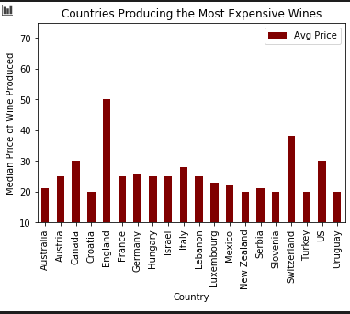
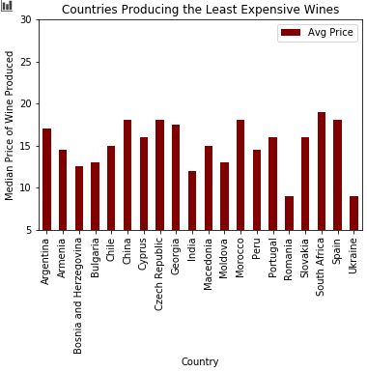
Price and Location
Which parts of the world are producing the most and least expensive wines?
The countries producing the most expensive wines are mostly Western European or North American countries, while those producing the least expensive are Eastern European or South American countries.
Notes:
I used median due to the high impact of outliers on mean. The results were similar to that of results using the mean. Countries well known for their wine (France, Italy, US- mainly California) are represented as having the most expensive wine produced in the world. The most interesting outlier here, is that of England with about a ten dollar median price jump over the others. While further research would need to be conducted, it might be due to the fact England is an island and it costs more to produce and ship the wine to other parts of the world. The least expensive wine producing countries are those not normally thought of as wine countries, with Ukraine and Romania’s median wine price at less than ten dollars per bottle. All of the least expensive wine producing countries are at a median of less than twenty dollars per bottle.
Combining these results with the previous slide, the countries producing the lowest rated wines are also the countries producing the least expensive wines. The countries producing the highest rated wines are those aso producing the most expensive wines.

Slide 10
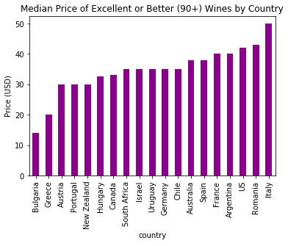
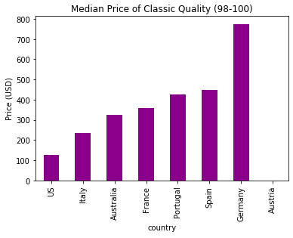
Location, Price, and Rating
Are all wines of a similar quality priced the same across the world?
With a few exceptions, 90+ wine costs between $30-40 worldwide.
If you want only the best wine (98-100), the prices vary significantly more:
* Prices were unavailable for Austria’s Classic-quality wine
Notes:
While there are some outliers like, Bulgaria, Greece, and Italy, most top quality wines will be found in a similar price range throughout the world
If you are traveling to Bulgaria or Greece, don’t overpay for your wine

Slide 11
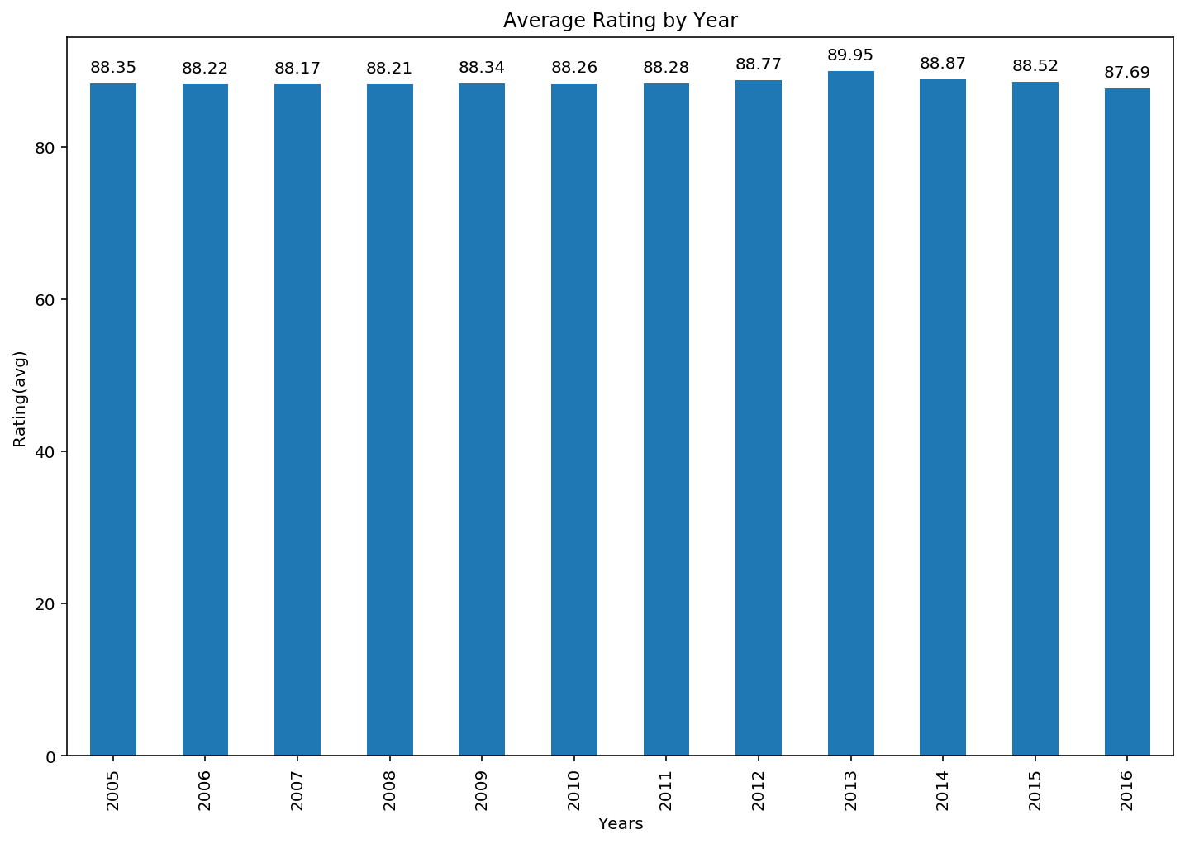
Time
Overall, there was very little variance of rating between the years that we looked at. The year 2013 turned out to be the best year but only by a modest .12 point margin with 2016 being the worst.

Slide 12
Limitations and
Problems
Our data only included wines rated 80+
Wine Enthusiasts scale starts at 50 (Undrinkable) but they only publish scores above 80.
We were unable to get a true representation of the average rating of all wines by price and country.
A number of questions we asked originally that we didn’t answer:
Do some reviewers give higher scores on average?
Which wineries produce the highest and lowest rated wines?
Which description/keywords about wines tend to be the highest rated?
Notes:
Ultimately, our analysis can tell you how much you should expect to pay for good wines, but paying that much for wine doesn’t guarantee it is good, even on average. It’s possible that 75% of $20 wines are poorly rated whereas 90% of $100 wines are highly rated. That’s something we weren’t privy to in this data set and would be interesting to research elsewhere
Our question about reviewers was ultimately uninteresting and deviated from our original goals about understanding wine ratings. Our audience (you all) likely didn’t care either unless we had found something profound
Our question on wineries was scrapped because there were too many wineries. On our smaller scale, like a wine tour through a specific country, it might have been more interesting and useful.
Lastly, our question on description proved more time consuming and difficult than we had wanted.

Slide 13
Final Thoughts
Key Takeaways :
Wine rating does increase with price, but matters most under $150. After that, it becomes less important.
Nebbiolo is the highest rated wine variety, while Rieslings and Portuguese Red are the most highly rated wines for the lowest price.
European wines (especially Austria, Germany, or France) are safe choices for top quality wines.
Year is not a key focus in selecting a good wine from the 2000s.
$30 to $40 was found to be a sweet spot to get a great wine
For Classic-quality wine, buying foreign can cost you 2-7x more for the same quality

